Slide 1

KONGUNADU COLLEGE OF ENGINEERING & TECHNOLOGY
(AUTONOMOUS)
NAMAKKAL- TRICHY MAIN ROAD, THOTTIAM DEPARTMENT OF COMPUTER SCIENCE ENGINEERING
3rd REVIEW
PROJECT GUIDE:
Dr . J. YOGAPRIYA M.E.,Ph.D., PROJECT TEAM:
ABINASH B DHARUN S
SATHIYANANTH P
BATCH NO:11
(621319104001)
(621319104013)
(621319104051)

Slide 2
ONLINE MESS TOKEN MANAGEMENT SYSTEM

Slide 3
ABSTRACT
The major goal of any canteen/mess is to give hygienic and fresh meals to the organization's students/employees.
It takes a long time and raises the risks of making a calculation error. If there were an online transaction and token reservation system, the same task could be completed in a shorter amount of time and with less effort and personnel.
The online platform will be an interactive website where students and others may register their tokens on their smartphones or laptops by following a few easy steps. The react.js library is used to start the website construction.

Slide 4
CONT…
The user must first choose the day they want to get the token, then the category they want (Veg/Non-Veg), then the tokens they require, and finally the amount they want to send through UPI/any online transactions.
They'll receive a bar code with restrictions after the order is placed.
They can gather the tokens as quickly as possible with this technique as compared to the prior methods.

Slide 5
INTRODUCTION
Over the past few years, the popularity of social networking sites (SNS) has increased immensely.
The basic objective of using the social networking sites is online communication and interaction.
Social networking sites and associated privacy concerns is one of the most debated topic nowadays as participation in such sites has increased dramatically.

Slide 6
LITERATURE SURVEY
J. Bonneau, J. Anderson, F. Stajano, and R. Anderson, “Eight friends are enough: social graph approximation via public listings,” in Proceedings of ACM SNS’09, 2009, pp. 13–18.
Title: Eight Friends Are Enough: Social Graph Approximation via Public Listings.
Author and Year : J. Bonneau, 2009
Techniques: Privacy Implication.
Merits : Enables transitive privacy loss.
Problem Description: Large number of profile data are listed.

Slide 7
A. Yamada, T. H.-J. Kim, , and A. Perrig, “Exploiting privacy policy conﬂicts in online social networks,” in Technical report, 2012.
Title: Exploiting Privacy Policy Conflicts in Online Social Networks
Author and Year: A. Yamada, 2012
Techniques: Permit-Take-Precedence framework
Merits: Preserve users’ sensitive information
Problem Description: Difficult to provide privacy to user posted data

Slide 8
N. Li, “Privacy-aware
display strategy in friend search,” in
Proceedings of IEEE International Conference on Communications (ICC), Communication and Information Systems Security Symposium, 2014, pp. 951– 956.
Title: Privacy-Aware Display Strategy in Friend Search
Author and Year: N. Li, 2014
Techniques: Inference privacy preservation
Merits: Protecting users’ relationship privacy
Problem Description: Only support synthetic datasets

Slide 9
L. Guo, C. Zhang, and Y. Fang, “A trust-based privacy-preserving friend recommendation scheme for online social networks,” IEEE Transactions on Dependable and Secure Computing, vol. 12, no. 4, pp. 413–427, 2015.
Title: A Trust-based Privacy-Preserving Friend Recommendation Scheme for Online Social Network.
Author and Year: L. Guo, 2015
Techniques: Attribute-based recommendation process
Merits: Establish trust relationships
Problem Description: Computational complexity is high

Slide 10
Z. Feng, H. Tan, and H. Shen, “Relationship privacy protection for mobile social network,” in Advanced Cloud and Big Data (CBD), 2016 International Conference on. IEEE, 2016, pp. 215–220.
Title: Relationship privacy protection for mobile social network
Author and Year: Z. Feng, 2016
Techniques: Privacy evaluation algorithm
Merits: Allows users to express their privacy requirements
Problem Description: Time complexity is high

Slide 11
EXISTING SYSTEM
Trust chain based friend recommendation : Trust score for each friends in social network
Privacy preserving scheme : Preserve the user’s profile details
Finer grained friend list display strategies : Filter out the malicious user details

Slide 12
Disadvantages
List can be collude with legitimate users.
There is no privacy in user uploaded data.
Time complexity is high in friend list selection
Graph and chain structure become complexity.

Slide 13
PROPOSED SYSTEM
Implemented Adopted Defense Scheme to analyze the malicious user details
Recommend the trust users to differentiate the legitimate users from malicious users
Extend the framework to implement image privacy based on filtering framework
Unauthorized only view the user data and not to access the data without user’s permission

Slide 14
Advantages
Easy to retrieve malicious user list
Time and computational complexity can be reduced
Provide image privacy
Difficult to access the user’s data
Real time alert system

Slide 15
Hardware Requirements
Processor
RAM
Hard disk
Compact Disk
Keyboard
Monitor
: Dual core processor 2.6.0 GHZ
: 1GB
: 160 GB
: 650 Mb
: Standard keyboard
: 15 inch color monitor

Slide 16
Software Requirements
Operating system
Front End
Back End
: Windows OS
: .PHP
: MY SQL

Slide 17
Modules Spilt-up
ONLINE SOCIAL NETWORK CONSTRUCTION
USER PROFILE ANALYSIS
SEARCH FRIEND LIST
IMAGE PRIVACY
ALERT SYSTEM

Slide 18
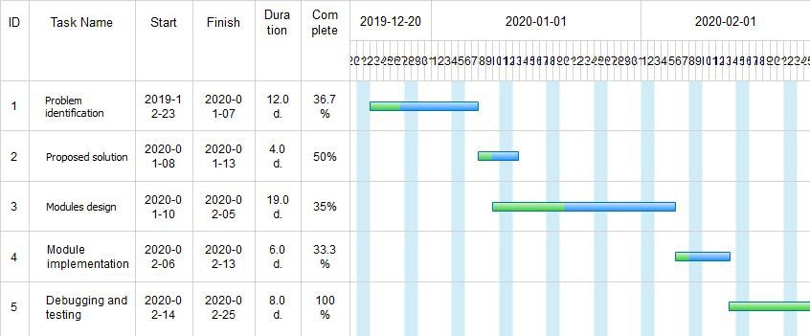
GANTT CHART

Slide 19
References
[1] J. Bonneau, J. Anderson, F. Stajano, and R. Anderson, “Eight friends are enough: social graph
approximation via public listings,” in Proceedings of ACM SNS’09, 2009, pp. 13–18.
[2] A. Yamada, T. H.-J. Kim, , and A. Perrig, “Exploiting privacy policy conﬂicts in online social networks,” in Technical report, 2012.
[3] N. Li, “Privacy-aware display strategy in friend search,” in Proceedings of IEEE International Conference on Communications (ICC), Communication and Information Systems Security Symposium, 2014, pp. 951– 956.
[4] L. Guo, C. Zhang, and Y. Fang, “A trust-based privacy-preserving friend recommendation scheme for online social networks,” IEEE Transactions on Dependable and Secure Computing, vol. 12, no. 4, pp. 413–427, 2015.
[5] Z. Feng, H. Tan, and H. Shen, “Relationship privacy protection for mobile social network,” in Advanced Cloud and Big Data (CBD), 2016 International Conference on. IEEE, 2016, pp. 215–220.

